Slide 1
Databases, DBMS and SQL
IICT Lecture

Slide 2
What is a Database?
An organized collection of Data
A comprehensive collection of related data organized for convenient access, generally in a computer

Slide 3
Database Model
Database model defines the logical design of data.
Database model describes the relation between different parts of data.
There are three database models:
    Hierarchical Model
    Network Model
    Relational Model

Slide 4
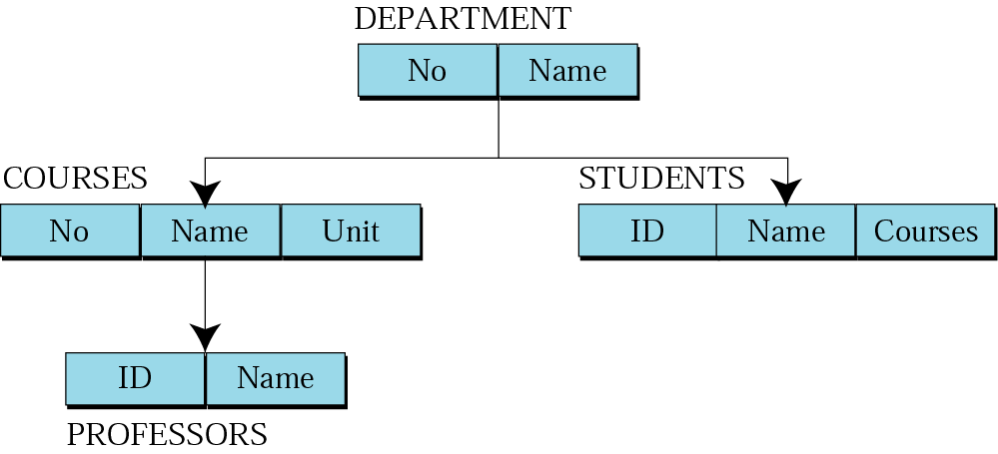
Hierarchical model
Data are organized in an upside down tree
Each entity has one parent and many children
Old and not used now

Slide 5
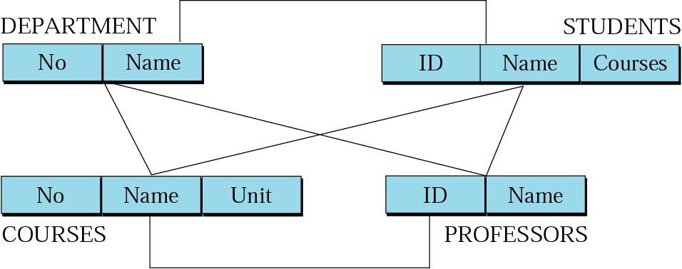
Network model
Entities are organized in a graph
Entities can be accessed through several paths
Old and not used

Slide 6
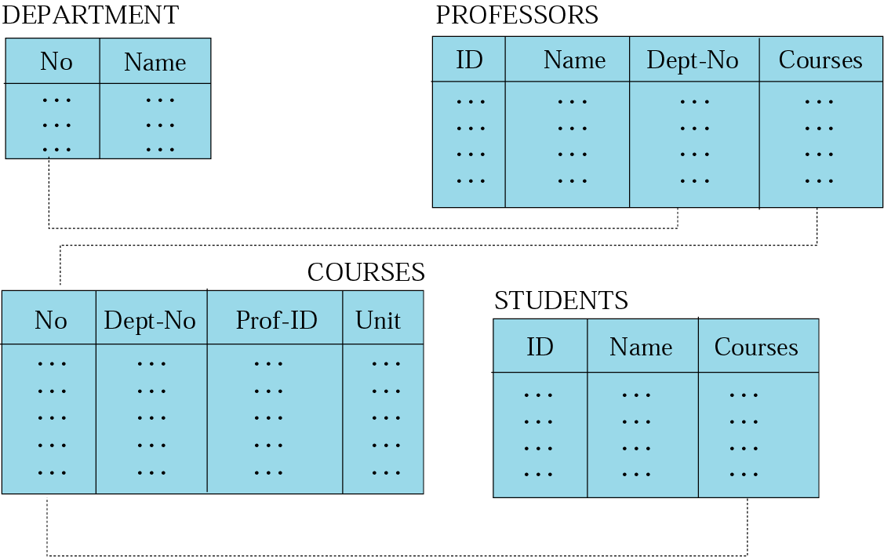
Relational model
Data are organized in two dimensional tables (relations)
Tables re related to each other
Relational Database Management System (RDBMS) are more common model used today

Slide 7
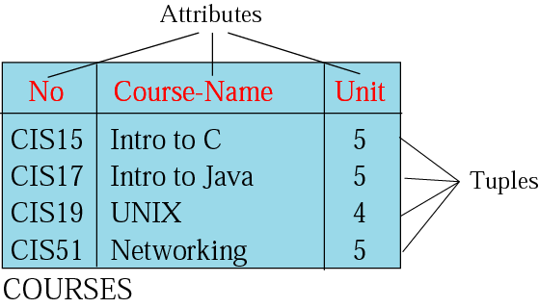
Relation (Name, Attributes, Tuples)
Attributes are the column heading
Each column must have a unique heading
Number of columns is called the degree of the relation
Tuple is a collection of attribute value
Total number of rows is called Cardinality of the relation
Each relation must have a unique name
Name
Relation appears in 2 dimensional table
That doesn’t mean data stored as table; the physical storage of data is independent of the logical organization of data

Slide 8
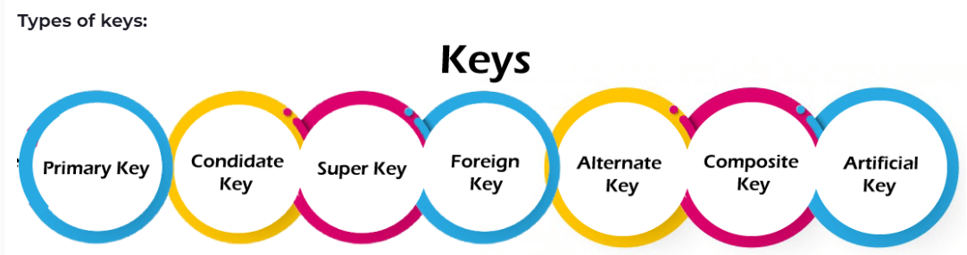
KEYS
An important constraint on an entity is the key. The key is an attribute or a group of attributes whose values can be used to uniquely identify an individual entity in an entity set.

Slide 9
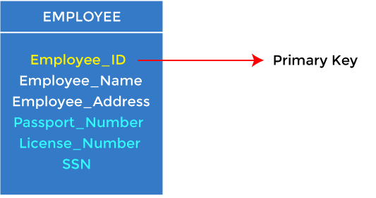
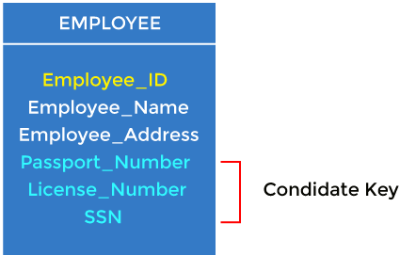
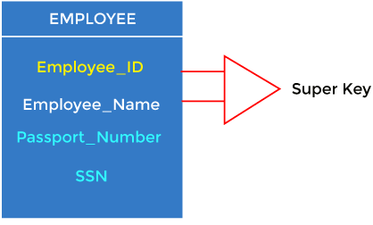
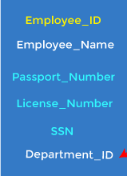

Primary Key
It is the first key used to identify one and only one instance of an entity uniquely. In the EMPLOYEE table, ID can be the primary key since it is unique for each employee.
Candidate Key
A candidate key is an attribute or set of attributes that can uniquely identify a tuple. In the EMPLOYEE table, id is best suited for the primary key. The rest of the attributes, like SSN, Passport_Number, License_Number, etc., are considered a candidate key.
Super Key
Super key is an attribute set that can uniquely identify a tuple. A super key is a superset of a candidate key. In EMPLOYEE table, for (EMPLOEE_ID, EMPLOYEE_NAME), the name of two employees can be the same, but their EMPLYEE_ID can't be the same. Hence, this combination can also be a key.
Foreign Key
Foreign keys are the column of the table used to point to the primary key of another table. We add the primary key of the DEPARTMENT table, Department_Id, as a new attribute in the EMPLOYEE table. In the EMPLOYEE table, Department_Id is the foreign key, and both the tables are related.

Slide 10
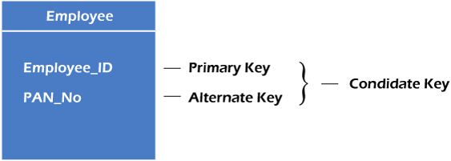

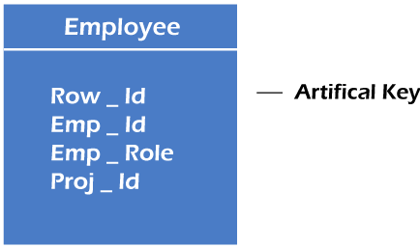
Alternate Key
One key is chosen as the primary key from these candidate keys, and the remaining candidate key, if it exists, is termed the Alternate key. If there is only one candidate key in a relation, it does not have an alternate key. Employee relation has two attributes, Employee_Id and PAN_No, that act as candidate keys. In this relation, Employee_Id is chosen as the primary key, so the other candidate key, PAN_No, acts as the Alternate key.
Composite Key
Whenever a primary key consists of more than one attribute, it is known as a composite key. This key is also known as Concatenated Key. in employee relations, we assume that an employee may be assigned multiple roles, and an employee may work on multiple projects simultaneously. So the primary key will be composed of all three attributes, namely Emp_ID, Emp_role, and Proj_ID in combination. So these attributes act as a composite key since the primary key comprises more than one attribute.
Artificial Key
The key created using arbitrarily assigned data are known as artificial keys. These keys are created when a primary key is large and complex and has no relationship with many other relations. The data values of the artificial keys are usually numbered in a serial order. Here, the primary key, which is composed of Emp_ID, Emp_role, and Proj_ID, is large in employee relations. So it would be better to add a new virtual attribute to identify each tuple in the relation uniquely.

Slide 11
OPERATIONS
ON
RELATIONS
An important constraint on an entity is the key. The key is an attribute or a group of attributes whose values can be used to uniquely identify an individual entity in an entity set.

Slide 12
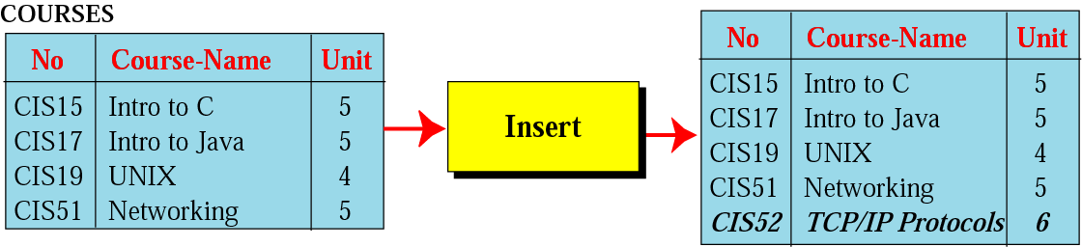
Insert operation
Unary operation
Insert Operation: Inserts new tuple into the relation

Slide 13
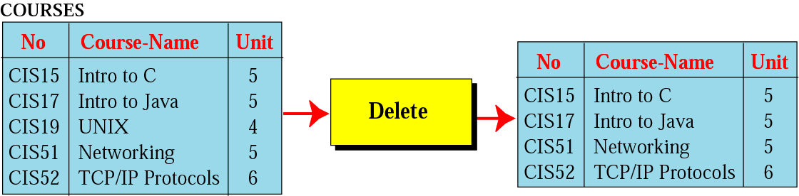
Delete operation
Unary operation
Delete Operation: Deletes tuple from the relation

Slide 14
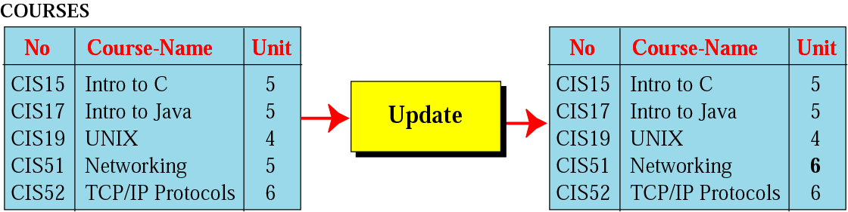
Update operation
Unary operation
Update Operation: Changes the values of some attributes of a tuple

Slide 15
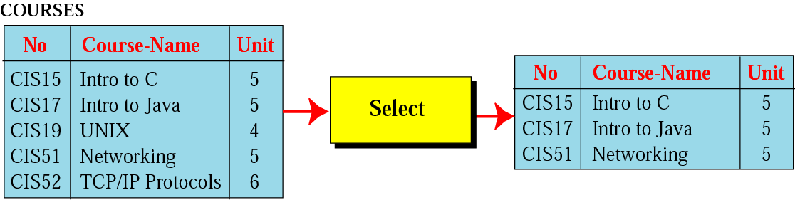
Select operation
Unary operation
Select Operation: Uses some criteria to select some tuples from the original relation

Slide 16
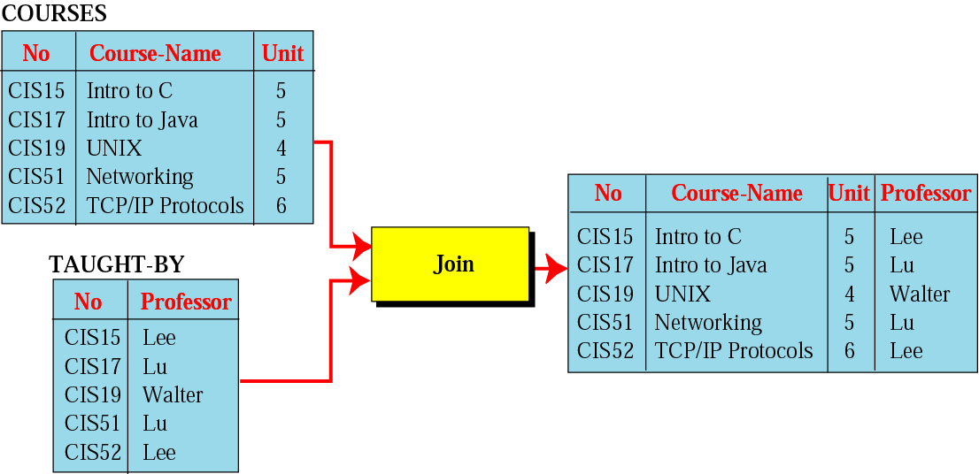
Join operation
Binary operation
Join Operation: Takes two relation and combine them based on common attribute

Slide 17
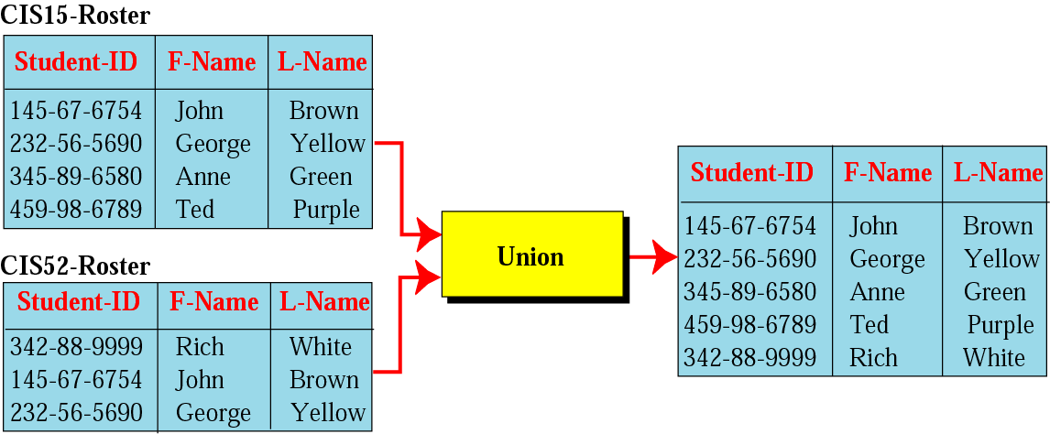
Union operation
Binary operation
Union Operation: Creates new relation in which each tuple is either in the first relation, the second relation or in both

Slide 18
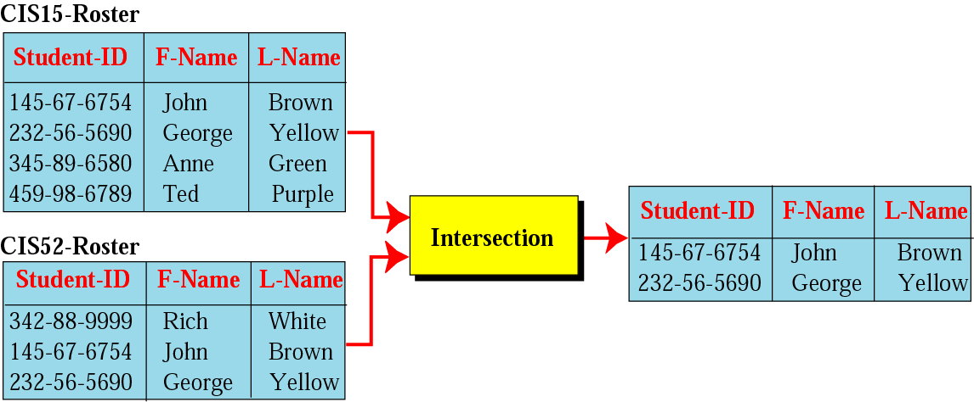
Intersection operation
Binary operation
Intersection Operation: Creates new relation in which each tuple is in both relations.

Slide 19
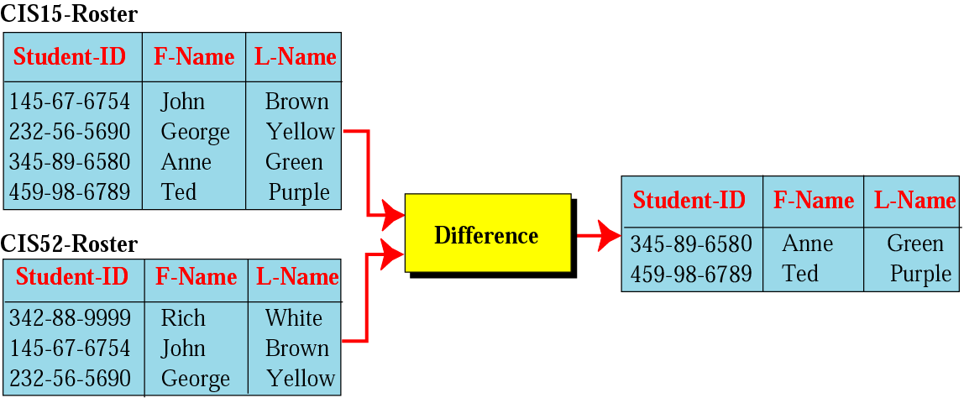
Difference operation
Binary Operation
Difference Operation: Creates new relation where the new tuples are in the first relation but not in the second.

Slide 20
Database Management System
A database management system (DBMS) is system software for creating and managing Database.
The DBMS provides users and programmers with a systematic way to create, retrieve, update and manage data.
DBMS allow all the operations on database discussed in previous slides
  Inserte, Delete, retrieve, Union, Join etc…

Slide 21
STRUCTURED
QUERY
LANGUAGE

Slide 22
SQL
SQL is the standard language used for relational databases.
It is declarative language where users declare what they want without having to write a step by stem procedure.
It was first implemented by Oracle Corporation

Slide 23
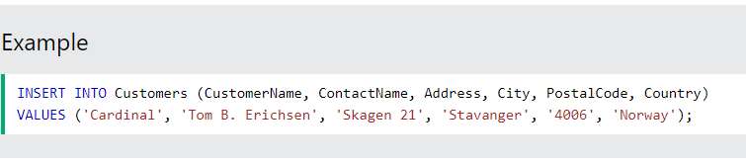
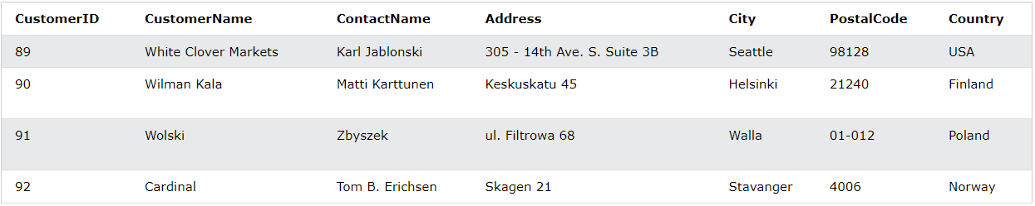
Insert
SQL Operation format
INSERT INTO table_name (column1, column2, column3, ...)
VALUES (value1, value2, value3, ...);
Notes:
Example is taken from w3school and the link is given below:
https://www.w3schools.com/sql/sql_insert.asp

Slide 24
Insert (Example)
*Write a clause for this case

Slide 25
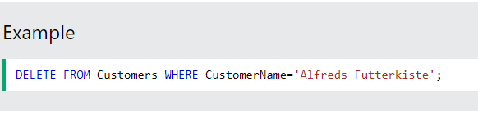
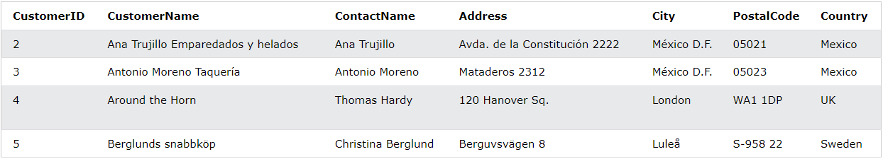
Delete
SQL Operation format
DELETE FROM table_name WHERE condition;
Notes:
Example is taken from w3school and the link is given below:
https://www.w3schools.com/sql/sql_delete.asp

Slide 26
Delete (Example)
*Write a clause for this case

Slide 27
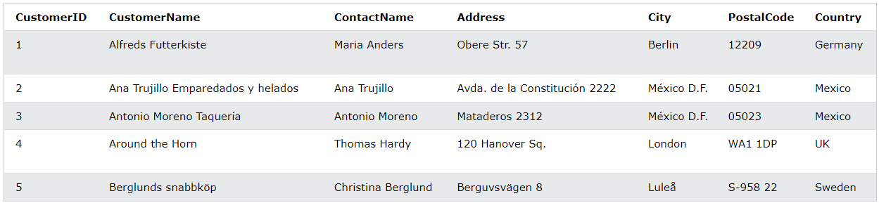
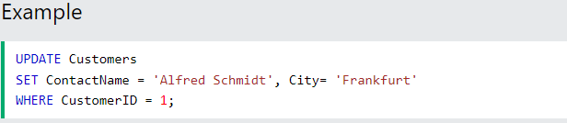
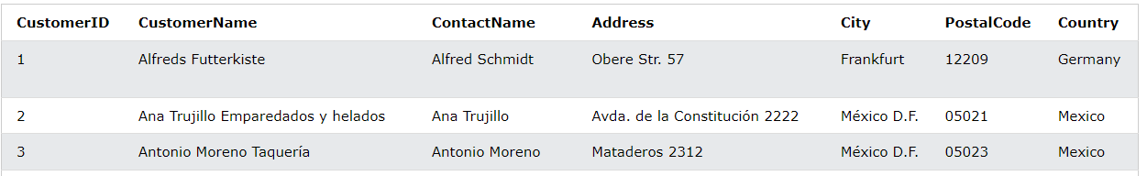
Update
SQL Operation format
UPDATE table_name
SET column1 = value1, column2 = value2, ...
WHERE condition;
Notes:
Example is taken from w3school and the link is given below:
https://www.w3schools.com/sql/sql_update.asp

Slide 28
Update (Example)
*Write a clause for this case

Slide 29


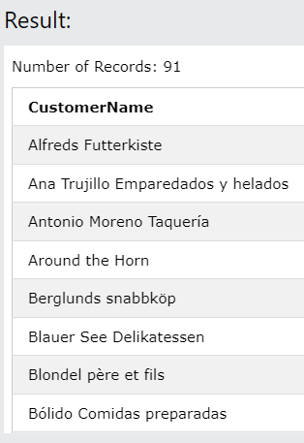
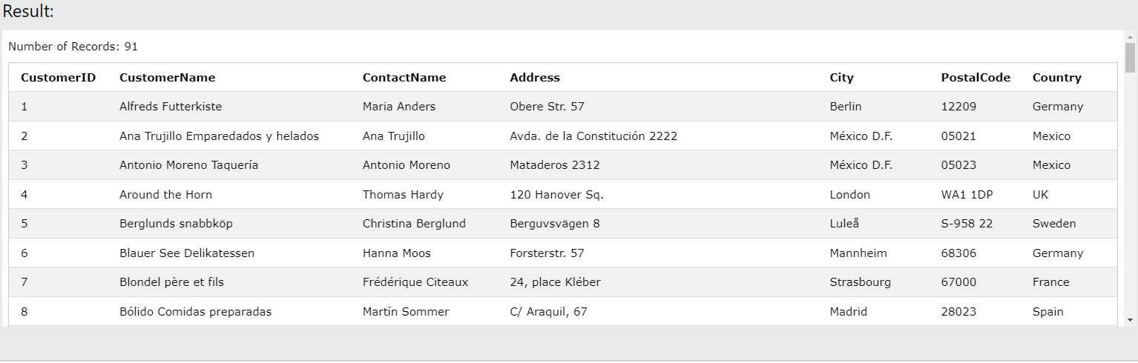
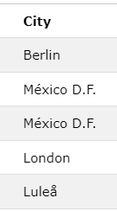
Select
SQL Operation format
SELECT column1, column2, ...
FROM table_name;
Notes:
Example is taken from w3school and the link is given below:
https://www.w3schools.com/sql/sql_update.asp

Slide 30
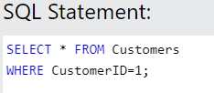
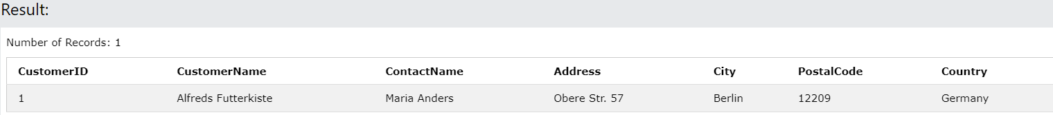
Where
SQL Operation format
SELECT column1, column2, ...
FROM table_name
WHERE condition;

Slide 31
Select (Example)
*Write a clause for this case

Slide 32
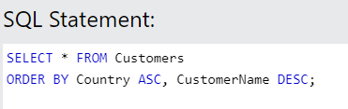
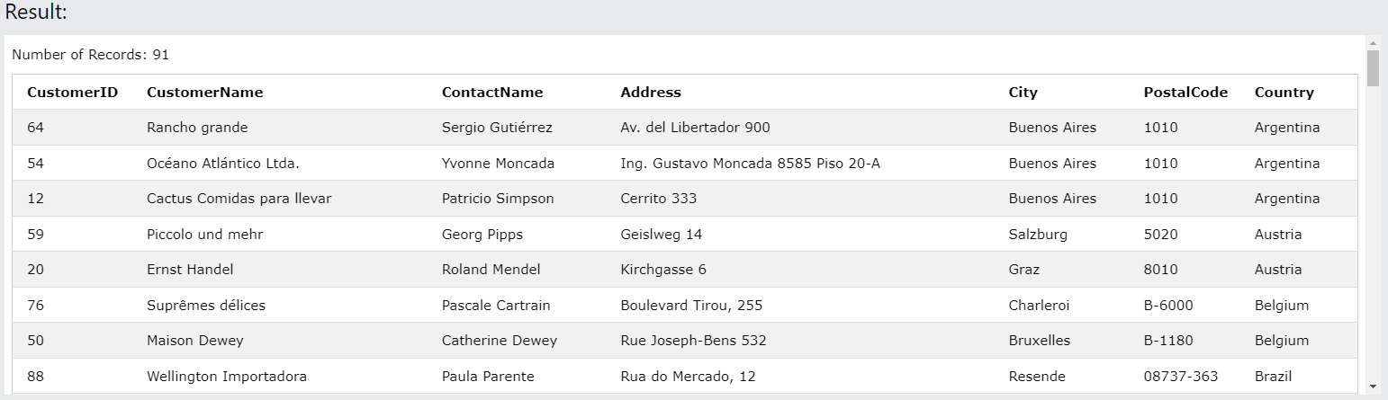
Group By
SQL Operation format
Used to sort the result-set in ascending or descending order
SELECT column1, column2, ...
FROM table_name
ORDER BY column1, column2, ... ASC|DESC;

Slide 33
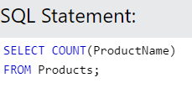
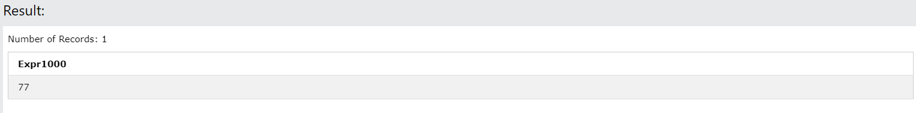
Count()
SQL Operation format
Function returns the number of rows that matches a specified criterion.
SELECT COUNT(column_name)
FROM table_name
WHERE condition;
Find the number of products where the ProductName is not null:

Slide 34
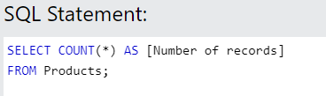
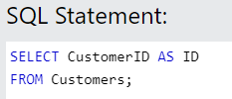
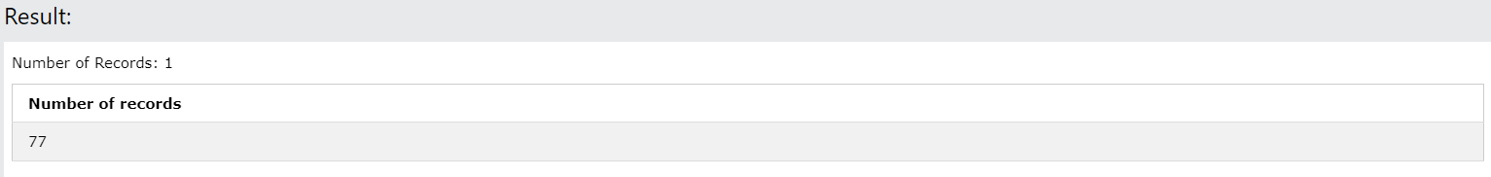
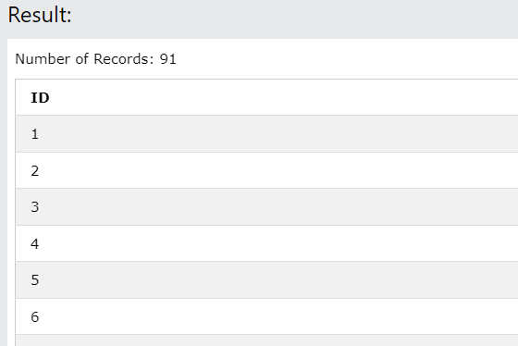
Alias
SQL Operation format
Give the counted column a name by using the AS keyword
SELECT COUNT(column_name)
AS alias;
FROM table_name;

Slide 35
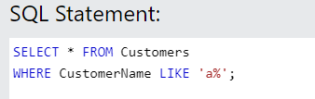
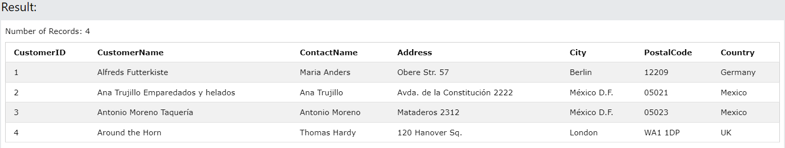
Like Operator
SQL Operation format
The LIKE operator is used in a WHERE clause to search for a specified pattern in a column.
There are two wildcards often used in conjunction with the LIKE operator:
The percent sign % represents zero, one, or multiple characters
The underscore sign _ represents one, single character
SELECT column1, column2, ...
FROM table_name
WHERE columnN LIKE pattern;

Slide 36
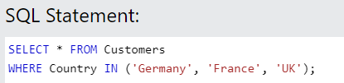
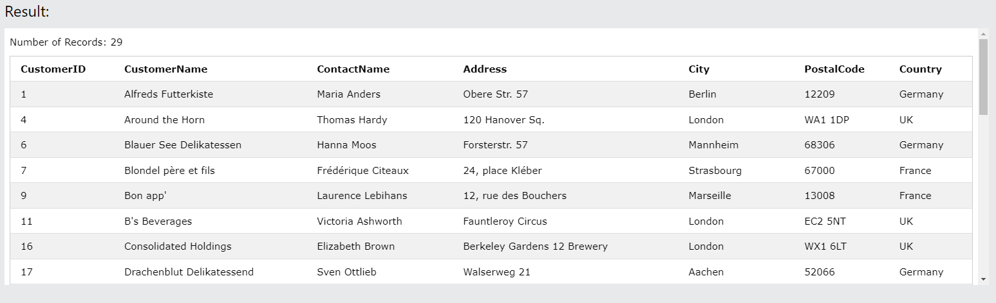
In Operator
SQL Operation format
The IN operator allows you to specify multiple values in a WHERE clause.
The IN operator is a shorthand for multiple OR conditions.

Slide 37
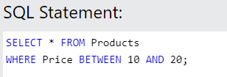
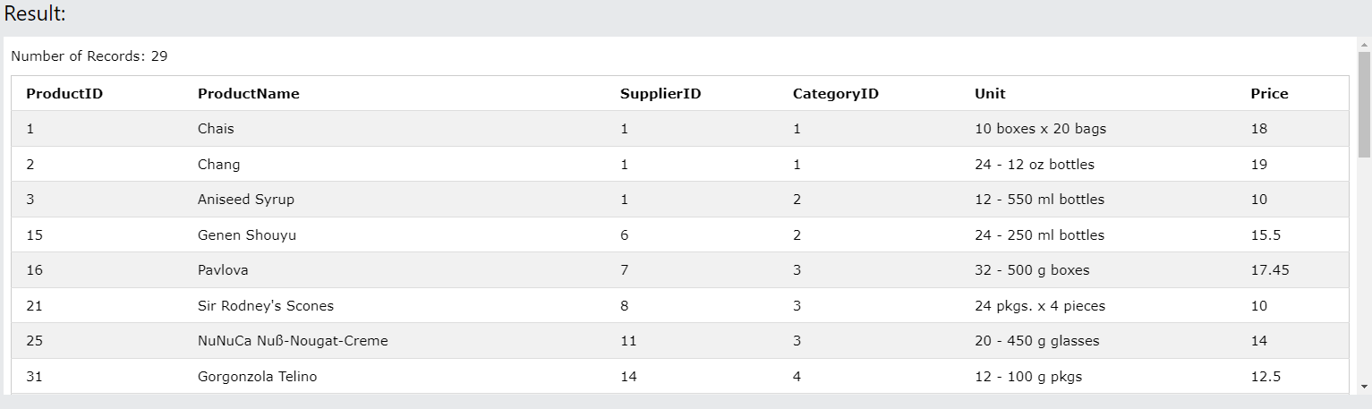
Between Operator
SQL Operation format
The BETWEEN operator selects values within a given range. The values can be numbers, text, or dates.
The BETWEEN operator is inclusive: begin and end values are included.

Slide 38
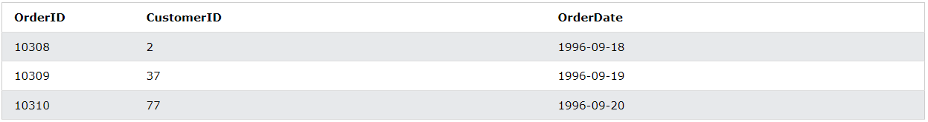
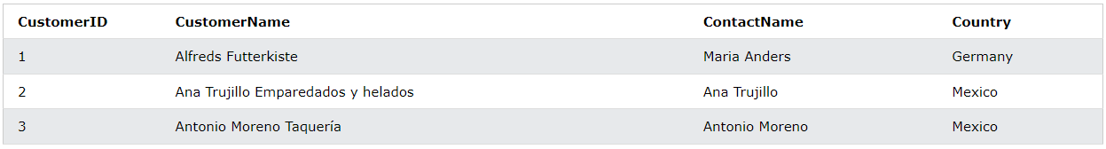
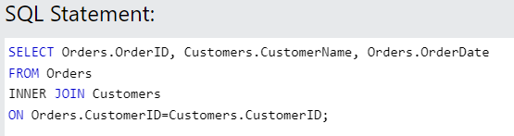
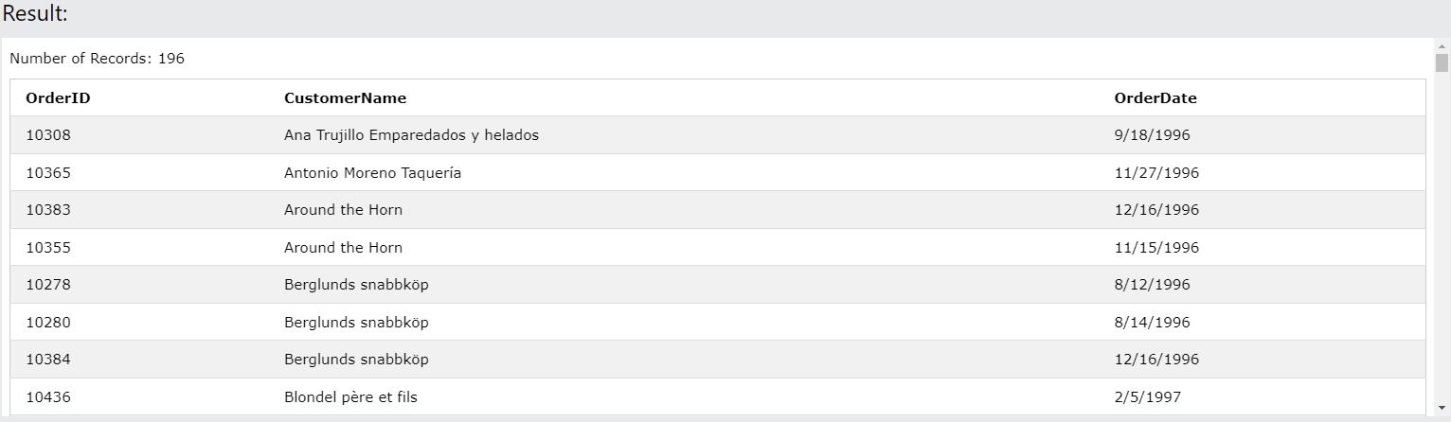
Join
A JOIN clause is used to combine rows from two or more tables, based on a related column between them.
Let's look at a selection from the "Orders" table and selection from the "Customers" table:

Slide 39
Join (Example)
*Write a clause for this case

Slide 40
Union
SELECT column_name(s) FROM table1
UNION
SELECT column_name(s) FROM table2;
The UNION operator is used to combine the result-set of two or more SELECT statements.
Every SELECT statement within UNION must have the same number of columns
The columns must also have similar data types
The columns in every SELECT statement must also be in the same order
SELECT column_name(s) FROM table1
UNION
SELECT column_name(s) FROM table2;

Slide 41
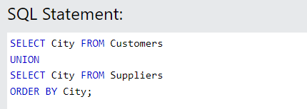


Union Activity
SELECT column_name(s) FROM table1
UNION
SELECT column_name(s) FROM table2;
What the statement below gives output:

Slide 42
Union (Example)
*Write a clause for this case

Slide 43
Intersection
In standard SQL, the INTERSECT clause is used to return the common rows between two SELECT statements (i.e., rows that appear in both result sets). It automatically removes duplicate rows, similar to DISTINCT.
SELECT column_name(s) FROM table1
INTERSECT
SELECT column_name(s) FROM table2;

Slide 44
Intersection (Example)
*Write a clause for this case

Slide 45
Difference
In standard SQL, the operation to find the difference between two result sets is achieved using the EXCEPT clause (or MINUS in some databases like Oracle). The EXCEPT clause returns the rows from the first SELECT statement that are not present in the second SELECT statement.
SELECT column_name(s) FROM table1
EXCEPT
SELECT column_name(s) FROM table2;

Slide 46
Difference(Example)
*Write a clause for this case

Slide 47
Important points
In MySQL, there are several situations where two SQL clauses or operations cannot be used together because of logical, syntactical, or functional restrictions. Below are examples of such cases, including basic and advanced scenarios:
DISTINCT with GROUP BY
Explanation: DISTINCT is used to remove duplicate rows, while GROUP BY aggregates rows based on specified columns. Using both together might lead to redundant operations.
Conflict: DISTINCT is unnecessary here because GROUP BY already performs the aggregation. The result is essentially grouped and distinct for each column.
DISTINCT with COUNT(*)
Explanation: COUNT(*) returns the number of rows, while DISTINCT removes duplicates. Using them together can lead to confusion in counting distinct rows.
Conflict: MySQL does not support DISTINCT * inside aggregate functions like COUNT. You have to specify a particular column for DISTINCT.
LIKE with Non-String Data Types
Explanation: The LIKE operator is used for pattern matching in strings. Using it with non-string data types, like numbers or dates, can produce errors or unexpected results.
Conflict: You cannot use LIKE for non-string data types without explicit conversion, as LIKE is intended for strings.
LIMIT with GROUP BY and Aggregates
Explanation: LIMIT restricts the number of rows returned. Using it with GROUP BY and aggregate functions can cause unexpected results.
Conflict: LIMIT doesn't influence the aggregation done by GROUP BY. It only limits the number of rows returned after the aggregation, but it could mislead in terms of the total dataset.

Slide 48
The levels of Data
Database | One or more tables
Table (relation) | A collection of Records
Record | A group of related fields
Field | One or more character
Character | At least 8 bits
Bit | 0 or 1

Slide 49
5 characteristics of Good Database
Data Integrity | Ensuring data is valid
Data Independence | Data is separated from software
Avoiding data Redundancy | Repetition of input data is avoided
Data Security | Data is not accessible to unauthorized users
Data Maintenance | Set procedures for adding ,deleting … records for the purpose of optimization

Slide 50
Tutorial on database
https://www.w3schools.com/sql/sql_intro.asp
https://www.youtube.com/watch?v=zpnHsWOy0RY&list=PLP9IO4UYNF0UQkBXlTMSw0CYsxv-GDkkI

